Slide 1
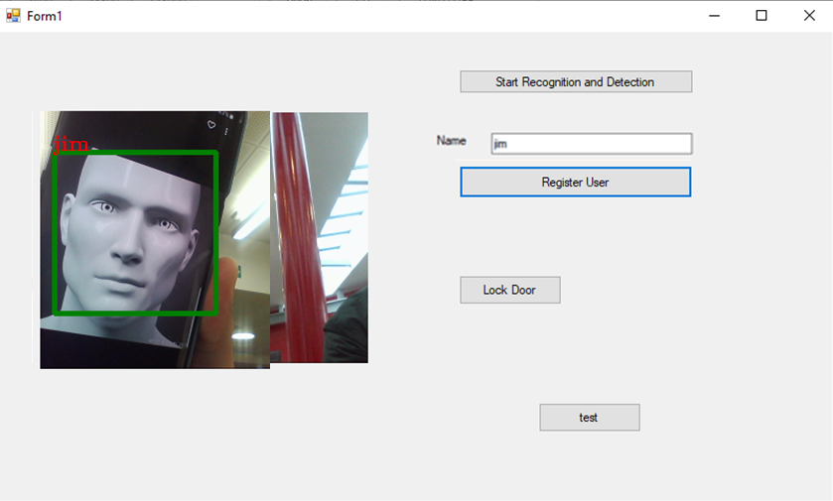
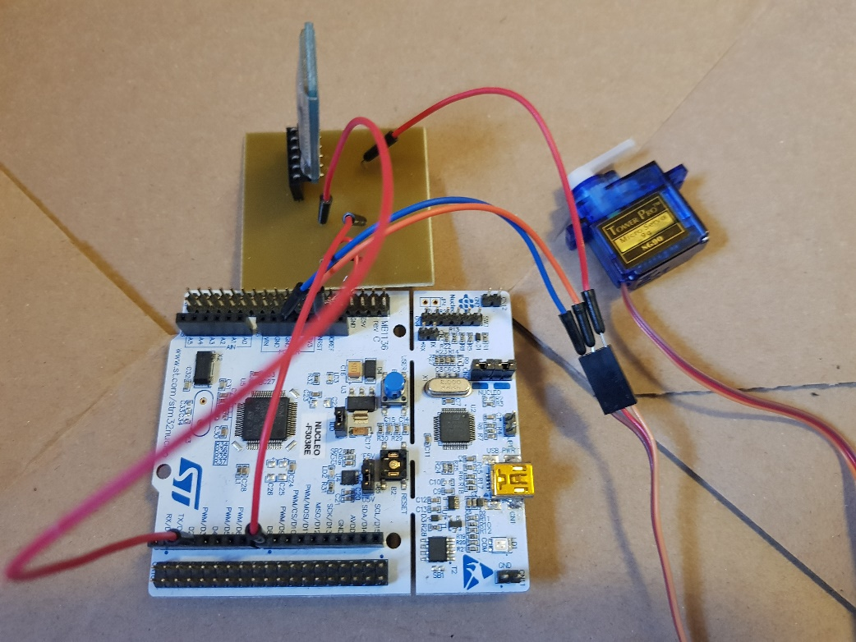

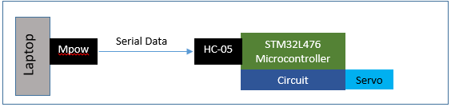
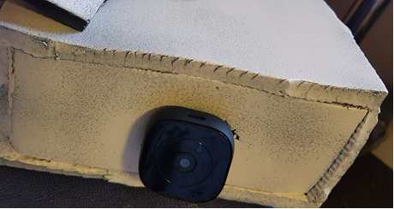
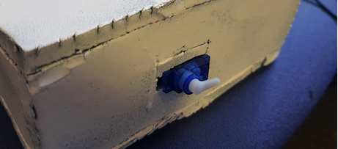
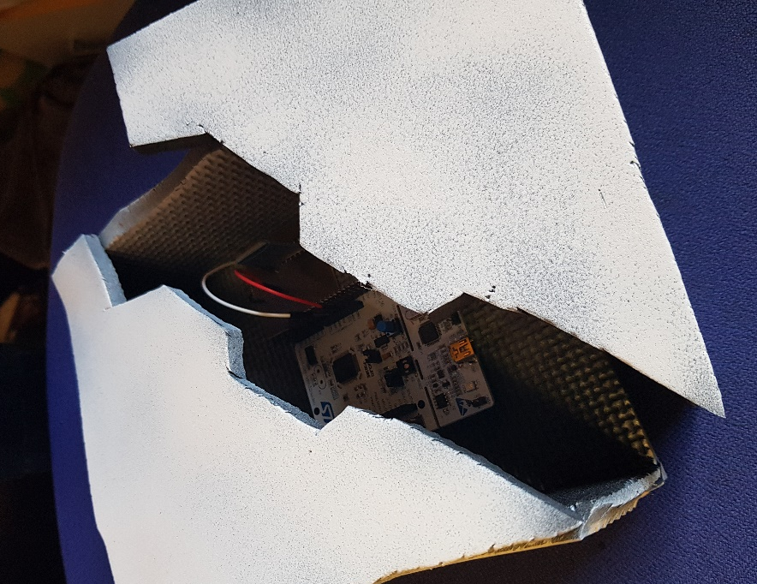
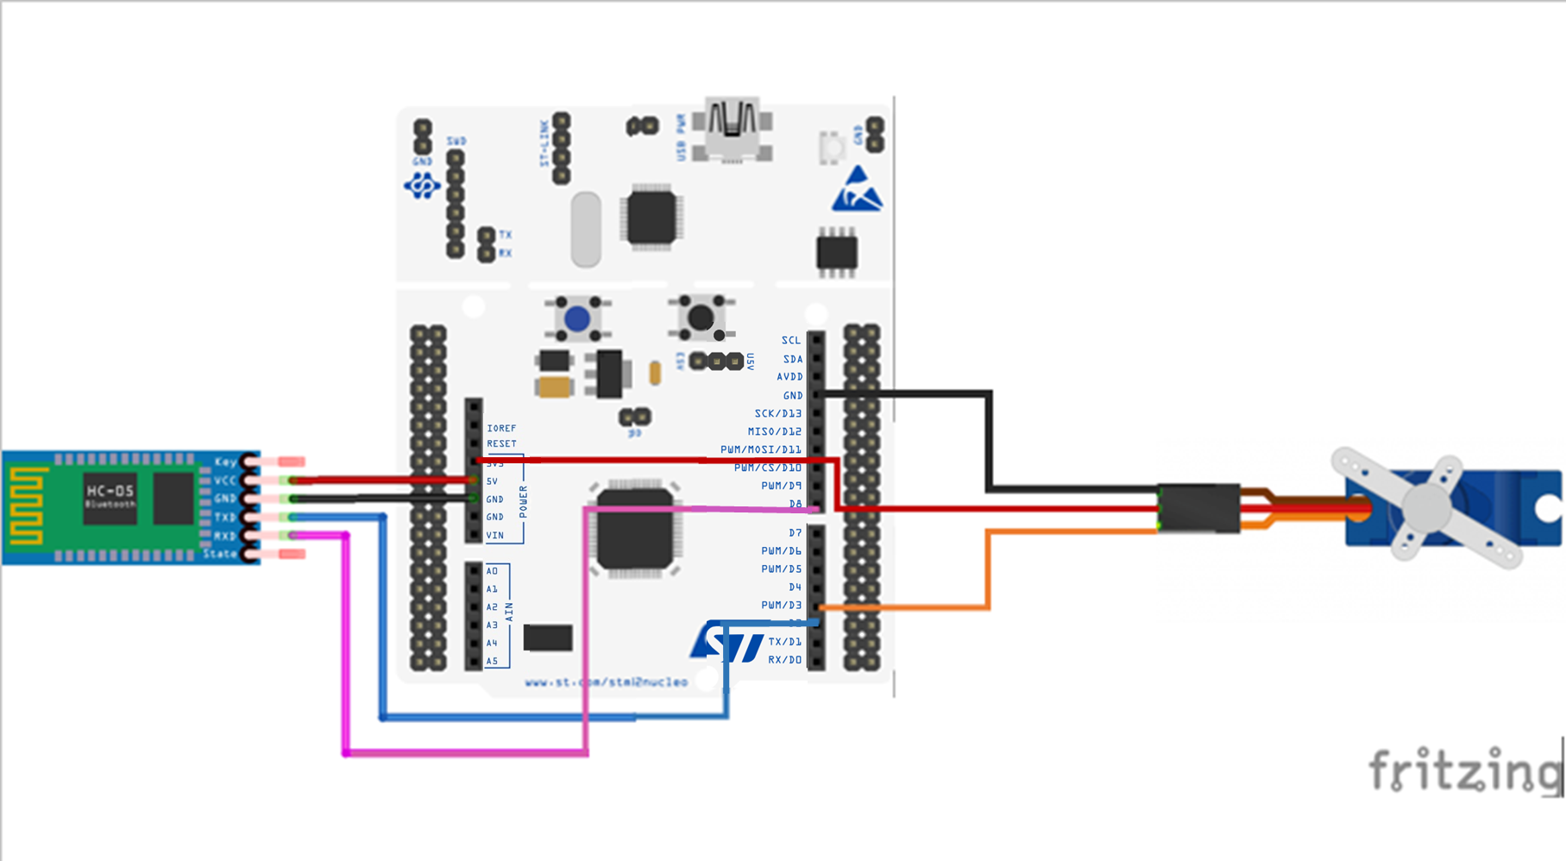
Face Recognition Security System
Alvydas Juodikis
School of Engineering
Introduction
Conclusion
Biometric security measures is becoming a necessary feature for securing homes and sensitive private environments. Particularly face recognition is a growing branch of pattern recognition in the area of images and vision (Vezzetti and Marcolin, 2015).
There are challenges when working with face recognition particularly with in the context of dealing with head positioning, facial expression, illumination, occlusion and different facial features Kumar et al. (2017). This project will explore the implementation of face recognition technology in the application of a home security system.
The project was split into different sections, the first being the development of software on visual studio, the second being serial transmission from visual studio to a HC-05 module and the third being the development of MBED code that allowed a microcontroller to interpret the serial data and proceed to activating a servo motor. Stress testing was used in each section to determine the limits of each area of the project. With the image recognition software, if was changing the light intensity and angles of a face captured until the system failed to recognise a user. This led to the conclusion that multiple images should be recorded under different lighting and angles to ensure optimum functionality and more reliable recognition.
If the project was taken further into production such as introducing emotion detection in the image recognition section to analyse if the user was in distress, potentially identifying if the user is being forced to unlock their home door. An IOT model would be explored by potentially experimenting with AWS to connect the security system and allow cloud applications; at this point the system may be developed to introduce more features and evolve into a home smart system.
Figure 4: Hardware Element of Project
Figure 1: Face Recognition Testing Carried out on Visual Studio IDE
Objectives
The predominant objectives of the project included the use of face recognition software that was capable of detecting and recognising registered users and respond to strangers attempting to enter the premises; the experimentation of serial data and the development of a PC to STM32L476 microcontroller interface.
The main goal of the project was to demonstrate the systems function by having the software interface to a stm32l476 microcontroller and for it to receive serial data, in which it can then accordingly proceed to activating or deactivating a lock.
The system has proven to be effective in differentiating different users and failure only appeared when a light source lit a face at only 20% of intensity. However despite the success of the systems accuracy the application involves the protection of a user’s home, family and well-being therefore relying simply on one system provides a potential risk of danger. The current system can most definitely be used to act as further protection in the case that a burglar or strange individual is attempting to enter a home through breaking and entering.
If the project was taken further into production such as introducing emotion detection in the image recognition section to analyse if the user was in distress, potentially identifying if the user is being forced to unlock their home door. A silent alarm would also be introduced that contacts local authorities. An IOT model would be explored by potentially experimenting with AWS to connect the security system and allow cloud applications; at this point the system may be developed to introduce more features and evolve into a home smart system.
Figure 2: Block Diagram of System Configuration of Serial Communication
Figure 5: Box to Store Hardware
References
Kumar et al. (2017). 'A Study on Face Recognition Techniques with Age and Gender Classification,' IEEE Conference. Greater Noida.
Vezzetti, E. and Marcolin, F. (2015). Similarity measures for face recognition.
Acknowledgements
Figure 3: Hardware Connections for STM32L476, HC-05 and Servo
I would like to thank my Academic advisor Bogdan Matsujewski for his expertise in face recognition methods and validation on the methods I have chosen to explore. I would also like to thank my EL3995 project lecturer Javad Yazdani for his help and advice in the areas of time managements and steps to take to ensure a successful project. I would also like to thank my mother for emotional support during my final year.

